Slide 1



Please use extreme caution and permitting required for burning General Email ramblingridgehoa@gmail.com President: Roy Smithers rorsmith@aol.com Vice President: Darrell Burnett bigdburnett@gmail.com Treasurer: Chris Frey crispy275@gmail.com Secretary: Linda Heller Linda@stampingschool.com At Large Board Members Cathy Shanks csterp5@gmail.com Paul Hooper defiant1970@gmail.com Kenny Perry Care Bears/Firewise Coordinator kpfasure@msn.com Private FB Group for RR: https://www.facebook.com/groups/RamblingFriends/
The Newsletter for the Rambling Ridge Community
April 3rd 2023 Page 1 of 5
Chipper day changed April 4th!
We received a surprise call tonight that the chipper crew needs to move up to tomorrow! We are excited to see so many piles around the neighborhood. Tuesday, April 4th, we should be hearing the chipping crew comin’ around the mountain!
It will take most of the day, possibly into the next day.
Remember no vines, bamboo or thorny branches!
Keep limbs under 6” diameter – thank you!
If you have a question or issue before, during or after, you can reach Kenny Perry at 248-408-7379
As I was typing this up, I paused to google who wrote the song “She’ll be comin’ around the mountain” and was surprised to see our Flat Rock famous Poet was mentioned. The first printed lyrics were in Carl Sandburg’s book, The American Songbag, in 1927. He wrote in his book that the original melody was from “when the chariot comes” adapted by railroad workers in the 1890’s.

Slide 2



April 3rd, 2023 Page 2 of 5
Our next Community Spring Meeting & Potluck will be SATURDAY, APRIL 29^{th!} Every resident is welcome to attend, whether a member or non-member. We’d love to meet you if you are new here! Bring a dish to share for lunch at Noon! We will eat and visit from 12-1 pm and the meeting will start promptly at 1 pm. Our President, Roy, will not be here due to a prescheduled trip but our Vice President, Darrell Burnett, will be leading the meeting.
 | Rambling Drive is scheduled to be surface treated from Cantrell Loop to Deer Run, which is at the intersection of Meadowood Trail. The contractor should begin the work on April 14th and are supposed to have it completed by October 13th. The HOA requested Grey Fox also be on the list with the buses and heavy traffic damage.
In our last newsletter we mentioned a possible plant swap day in Rambling Ridge. If you are interested, be sure to share information on what plants you have, what you might be looking for, your name and contact info and if you are willing to dig your own or need help. Call or text Chris Frey at 734-478-2094 Email crispy275@gmail.com or fill out the Google Doc HERE

Slide 3
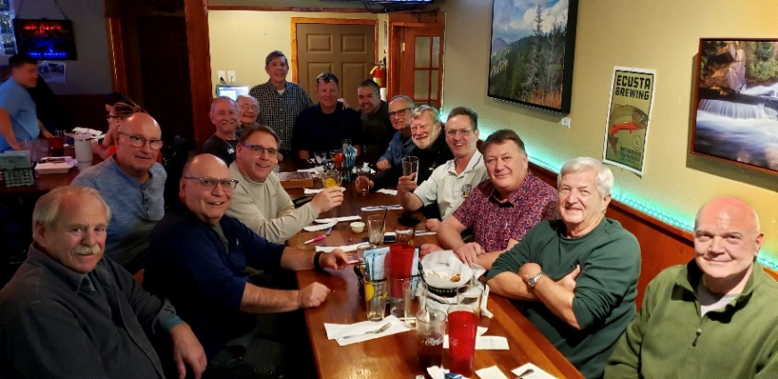

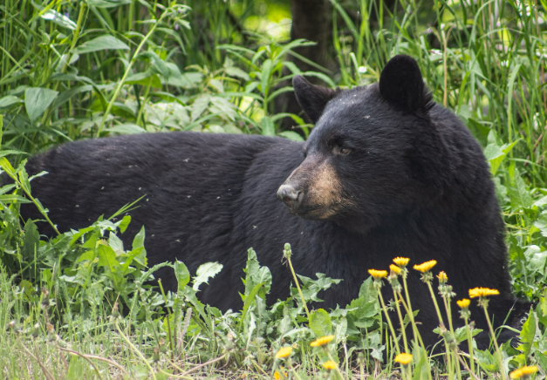
April 3rd, 2023 Page 3 of 5
 | RAMBLING ROWDIES GUYS NIGHT OUT is the first Wednesday of each month! Wednesday, April 5th at 6:30 pm at Blue Ridge Pizza 6336 Brevard Rd in Etowah Contact Matt to rsvp mattheller2668@gmail.com
April Ladies Lunch Bunch will be at Eagle Bar & Grill at Cummings Cove Wednesday, April 12th at NOON 925 Lake Ledge Court Hendersonville, NC 28739 Menu click HERE Restaurant Phone: 828-702-3613 RSVP by April 10th to the HOA secretary via email at Linda@stampingschool.com
The bears are out and about the neighborhood!
We have heard several reports of hungry bears knocking down bird feeders and tipping over garbage cans. Here are a few tips to keep you and our pets safe during bear cub season:
- put your lidded, secured trash cans out the morning of trash pick up, not the night before.
- Bears love bird seed, suet and humming bird nectar!
Bring in your feeders at night. Don’t store bird seed or other food on your screen porch where they can smell it and break in.
- If you happen upon a bear, stay calm and do not run. Stand your ground, talk loudly in a lower tone, slowly wave your arms to become large. If you encounter a mama bear and cubs, it’s not the time to try to get a photo (although we are tempted). If she thinks you are a danger, she will protect her cubs. Always have your cell phone with you when walking alone to call for help.
See more bear safety tips at
https://www.asheville.com/news/2023/03/staying-safe-around-bears/

Slide 4

April 3rd, 2023 Page 4 of 5
We have heard of phone call scams but the scammers are getting better at tricking us! Beware of the following email scams: - An email invoice or a bill for an item you didn’t purchase. I received an invoice from a antivirus program for $400, which looked legit but was not. Don’t pay a bill online unless you are very sure. Delete. - A refund from Amazon sounds wonderful BUT they will not email or text you to start the refund process. Delete. - Phone texts can also be scams. Ex: Netflix texts you to call and update a payment. Instead login to your Netflix account to verify – don’t pay something over a text. If you don’t know them, don’t answer back, even a wrong number can be just a foot in the door to talk to you. Delete. - A text or call from a friend who is in another country and needs money. Delete. | Another example is the fake virus or tech support scam. Your computer gets a pop up window that says you have a virus and wants you to call this number to get it cleaned up. They may even threaten to lock your computer. Exit the webpage immediately, turn off the computer, wait 10 minutes and then restart. Run your virus program for a full system scan. The NY Times gave this advice: “If the window is hard to close with a click, you may not have to restart the computer to ditch the message. If pressing the Alt and F4 keys on a PC (or the Mac’s Command and Q keys) does not close the program, try force-quitting the browser by pressing the Control, Shift and Escape keys to get to the Windows Task Manager — or by pressing the Command, Shift, Option and Escape keys on a Mac. Make sure your browser is set to block pop-up windows and not to reopen the previous pages when it starts. ” If all that is too much, just shut down and call a computer repair business. We have a few techy people on our Care Bear team here in RR also who can try to help. The Better Business Bureau also has a website to verify legitimate or scam scenarios: https://www.bbb.org/scamtracker
Be vigilant, be skeptical and when in doubt, DELETE.

Slide 5
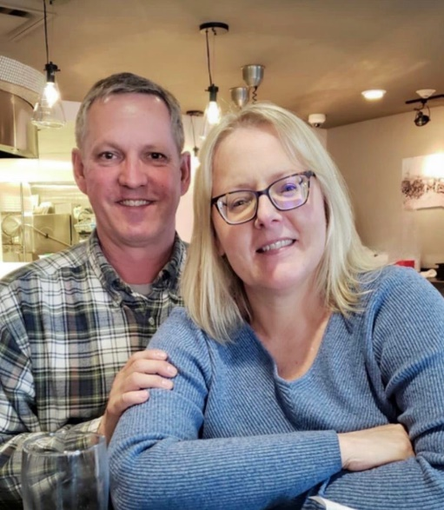
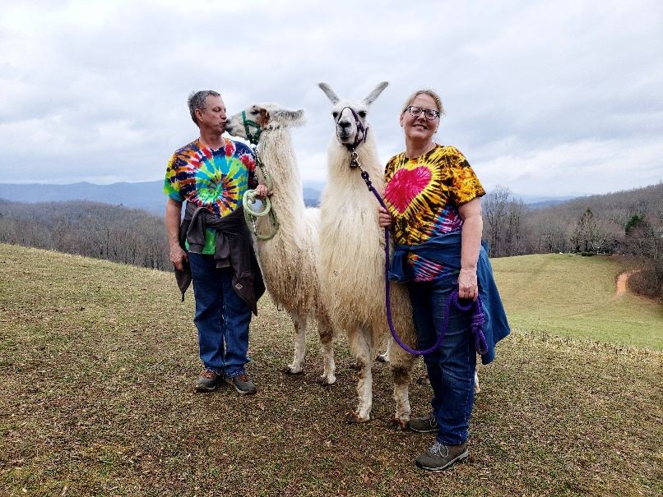
Neighbor Spotlight: Meet Chris & Kris Frey! | April 3rd, 2023 Page 5 of 5
How long have you lived here in Rambling Ridge and how did you find us ? We retired on August 31st, 2018 after 32 years working at Ford. We actually sold our 150 year old Victorian home two months prior, put most of our possessions into storage and were living in a friend's rental condo nearby. Two days after retirement we drove to Asheville where Kris had arranged a month-by-month rental home. We used this as a home base while we researched the market. We actually found our home on our own via an open house and moved in November 2018. What did you want to be when you grew up and did it turn out that way? Chris: Growing up as a child, I watched all of the Mercury, Gemini and Apollo missions and I wanted to be an astronaut. As I got older and the space program faded, I switched gears and decided I wanted to be in marketing and sales (like my dad). During my career I held multiple positions but found my muse developing products and the strategy on their development and launch. Kris: I wanted to work in the Detroit Tigers organization (I was a baseball fanatic in the true sense of the word). I went through a short phase of wanting to be a pilot, but my vision is awful. I settled on computer programming thinking it would be me and the machine (true introvert that I am) and it was anything but. | What do you like to do in your free time? Chris: I am an avid homebrewer, creating fermentables such as beers and meads. Visiting local waterfalls, hunting for cool items at local thrift stores, travel, taking walks and gardening round out our days. Kris: I love interior design - so I always like having a project or planning one, much to Chris' dismay. I buy and resell items from auctions, thrift stores and estate sales. I collect art glass and I like to organize stuff. I love to cook and try new recipes! Do you have a favorite restaurant in our area? We are blessed with any number of fun eateries in the area but if I had to pick one, I would choose Never Blue in downtown Hendersonville. What do you love about the neighborhood? Chris: The friends we have made and the western view of the mountains from our home. I had to stop looking at that view when we checked out our home during the open house and concentrate on the home itself. Kris: It is so quiet! I am a country girl and didn't know how much I missed that.
Chris and Kristine Frey met online in 2002 and married 14 months later. They are Match.com success story.
Chris is our volunteer HOA Treasurer, also!

